Slide 1
Restaurant Analytics
An end-to-end Snowflake-based Restaurant Analytics Platform that ingests , transforms and visualizes restaurant data to deliver actionable insights through dashboards and AI-powered querying .
Presented by : Palash Mahapatra , Ankit Sarkar , Nandita N , Diptendu Bhattacharyya , Shristy Singh
Guided by : Mr. Babjee Reddy | Co-Ordinator: Akanksha Thakur

Slide 2
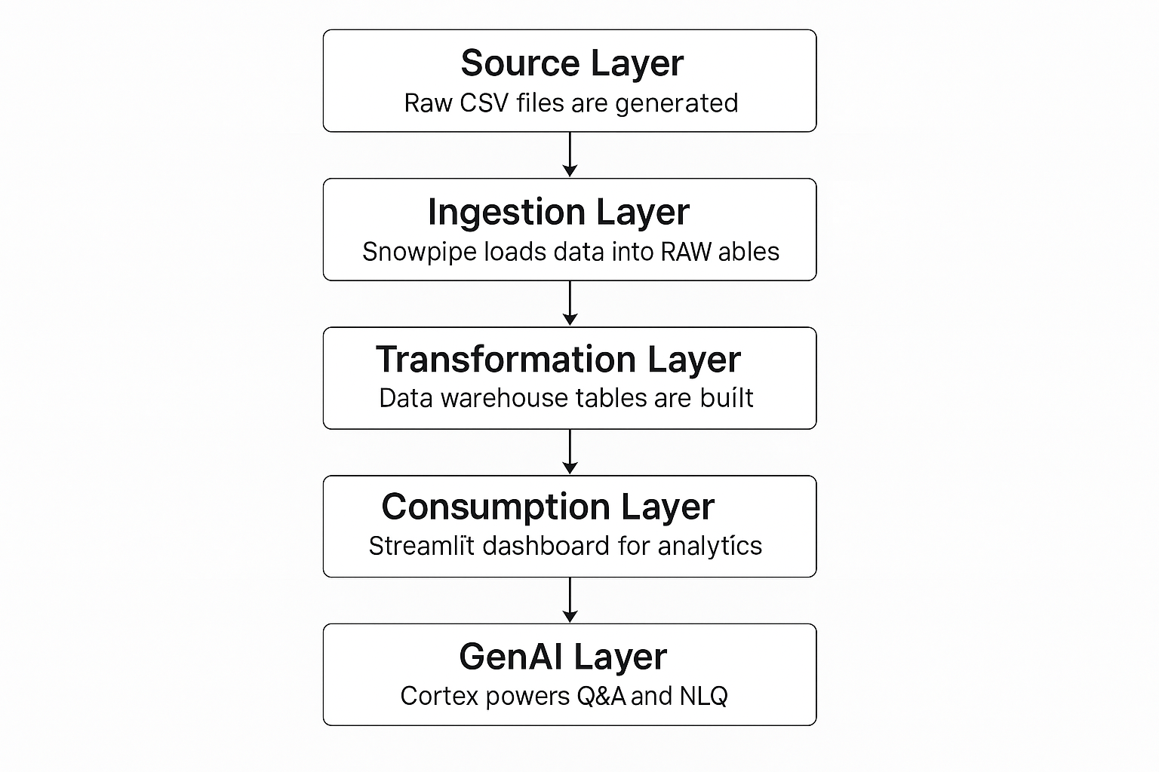
Scope of the Project
Source Layer
Ingestion Layer
Transformation Layer
Consumption Layer
Gen AI Layer

Slide 3
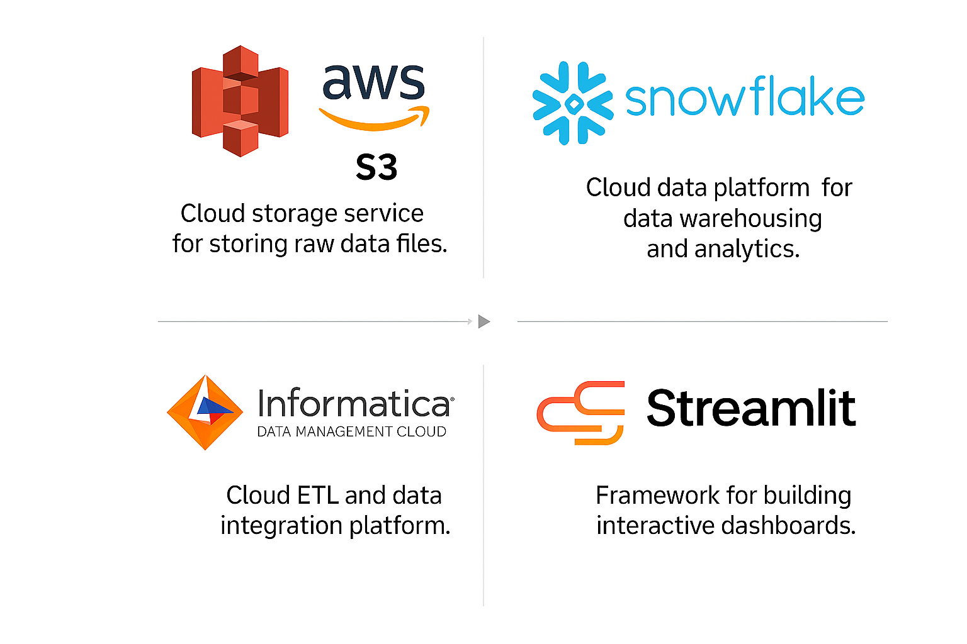


Tech Stack
AWS S3
IDMC
Snowflake
Streamlit

Slide 4
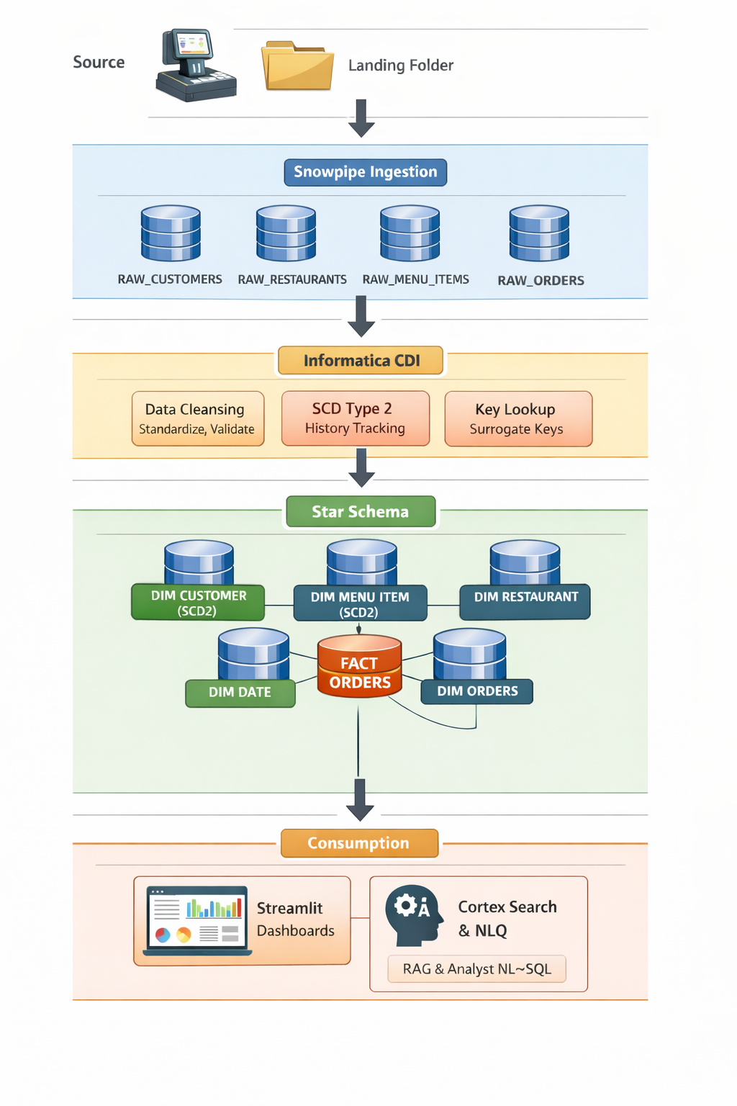
Architecture Diagram
Automated Data Ingestion: Source data lands in a staging folder and is continuously ingested into Snowflake raw tables using Snowpipe for near real-time loading. Data Processing & Transformation: Informatica CDI performs data cleansing, validation, surrogate key generation, and SCD Type 2 processing to maintain historical data. Dimensional Data Modelling: Processed data is structured into a star schema with dimension tables and a central fact table for optimized analytical querying. Analytics & Consumption Layer: Business users access insights through Streamlit dashboards and AI-driven natural language querying via Cortex Search.

Slide 5
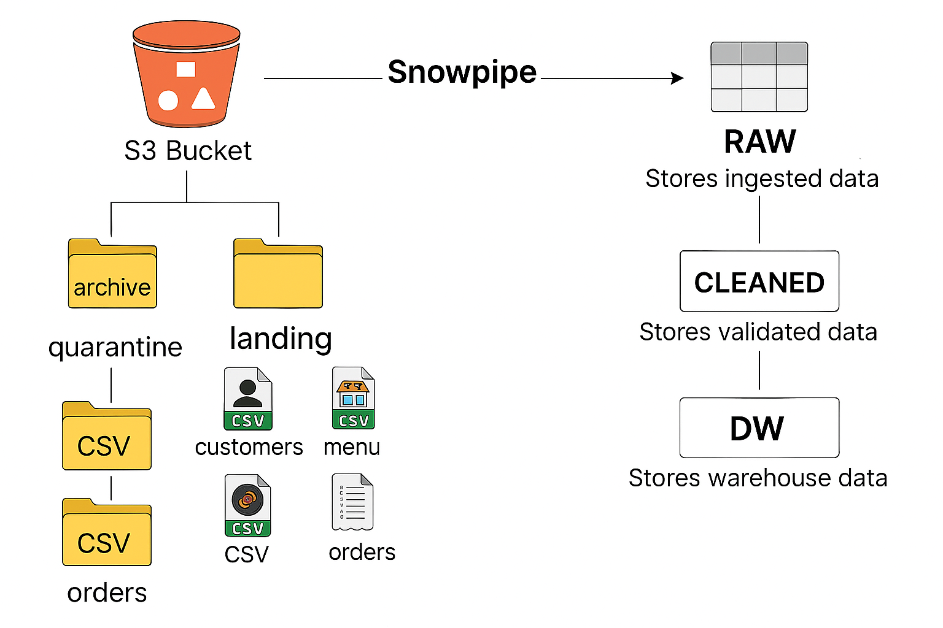
Source Layer
S3 bucket
- Landing
- Quarantine
Ingestion Layer
Schemas
Tables
Storage Integration
File Format
Stage
Pipes
Source Layer
Ingestion Layer

Slide 6
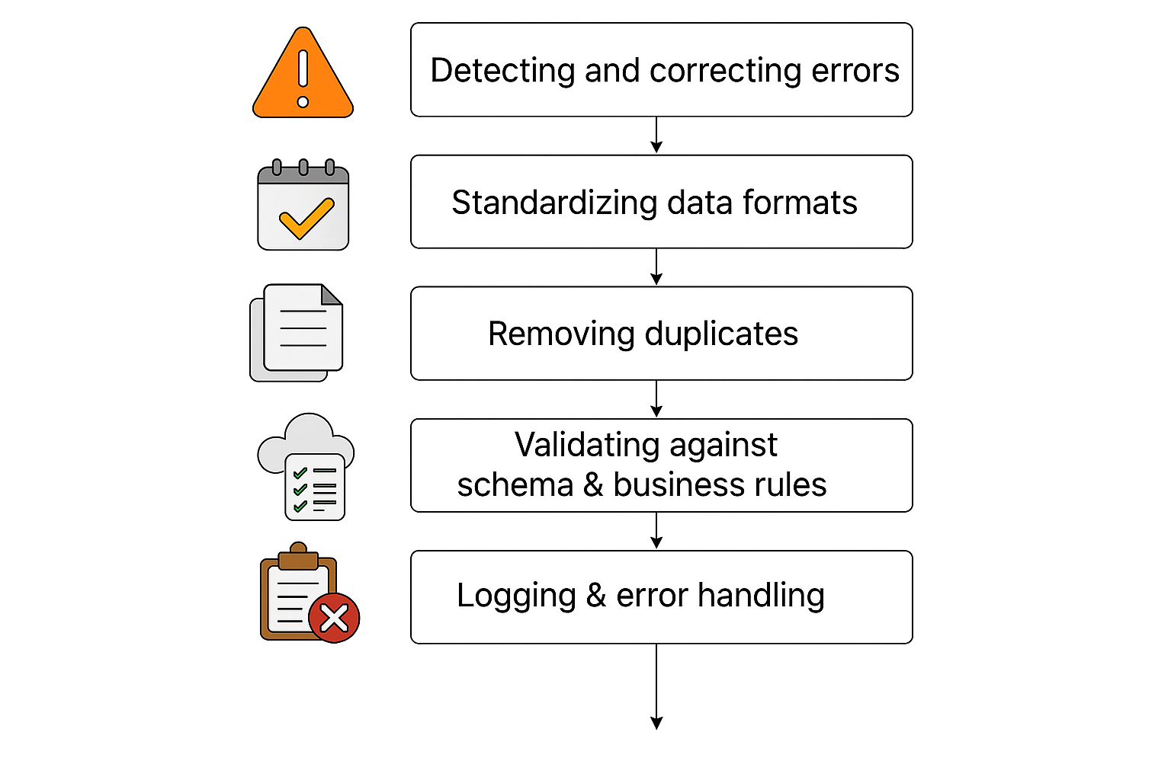
Transformation Layer
Anomalies in Raw Data :
1. Duplicate Values
2. Invalid Date Format
3. Null Values
4. Email Validation
Cleaned schema of Restaurant Analytics DB

Slide 7
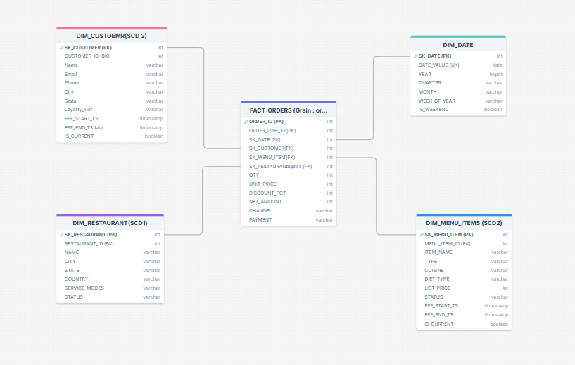
Star Schema Diagram :

Slide 8
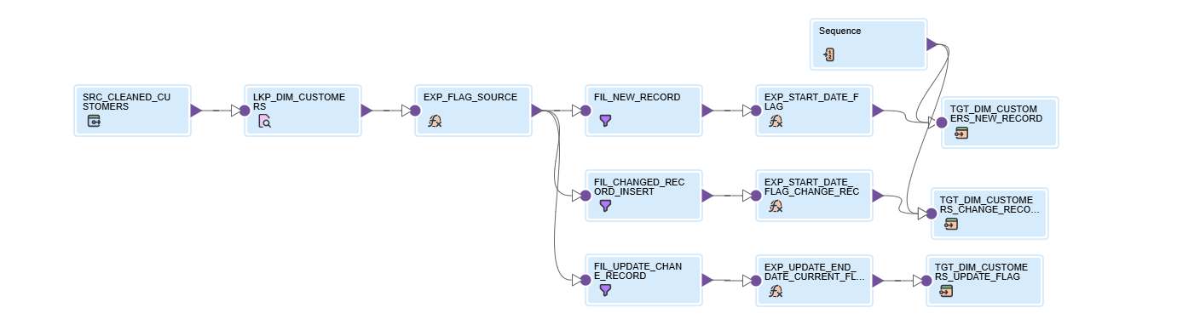
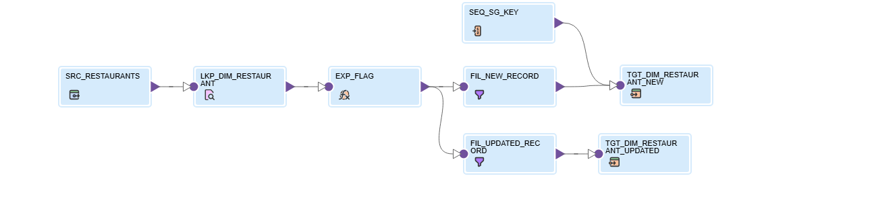
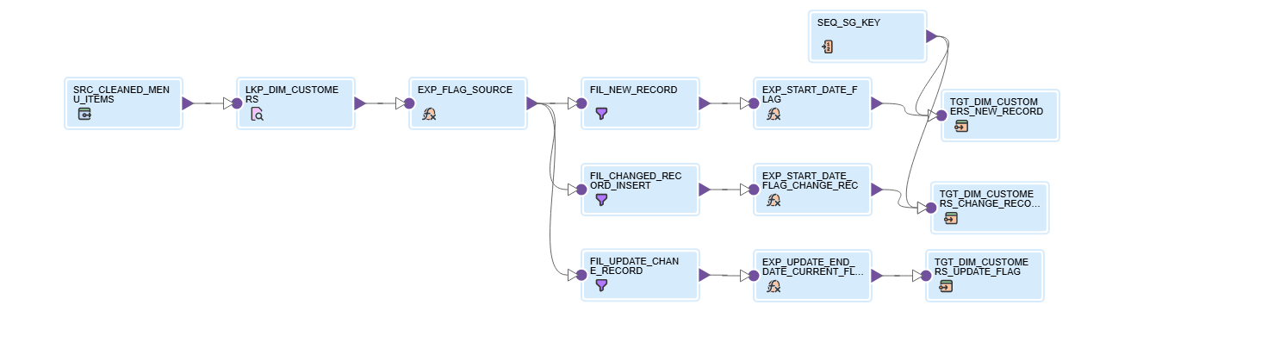
Transformations
Fig : DIM_RESTAURANTS (SCD 1)
Fig : DIM_CUSTOMERS (SCD 2)
Fig : DIM_MENU_ITEMS (SCD 2)

Slide 9
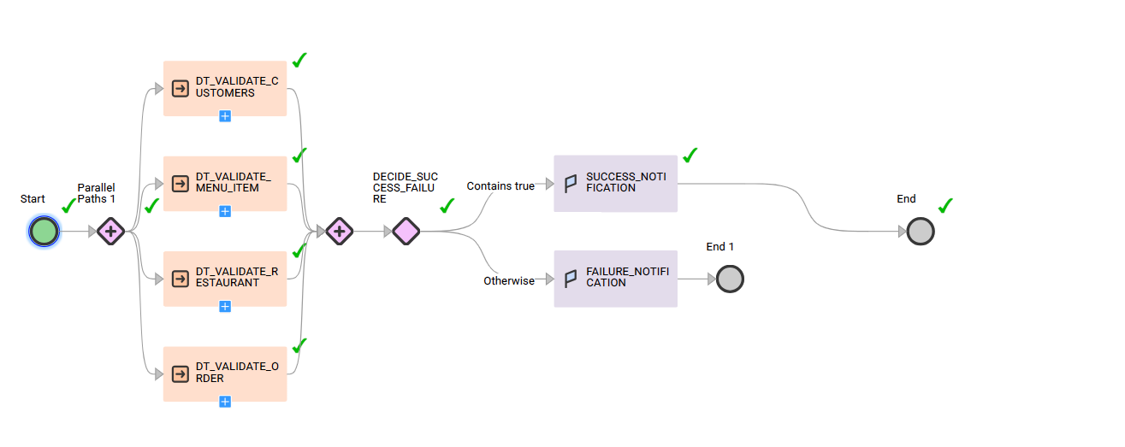
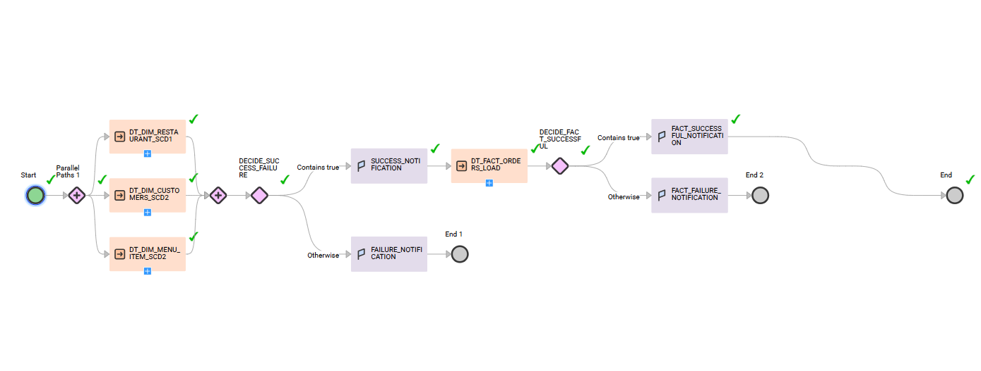
Task-flow
Ensures the correct order of loading
Handles SCD logic smoothly
Automates entire ETL Pipeline
Improves Maintainability and Monitoring
If any mapping fails, breaks the pipeline
Fig : Cleaning Task Flow
Fig : Fact and Dimension Table Task Flow

Slide 10
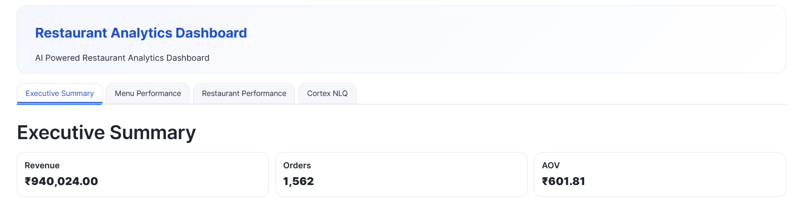
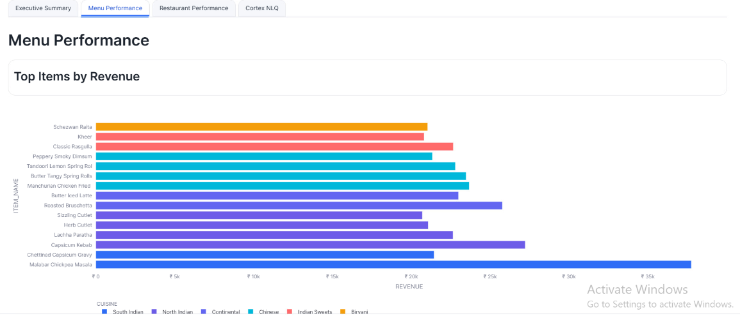
Consumption Layer
Executive Summary
- KPIs
- Filter
Restaurant Performance
- Revenue
- Region
- Peak Days
Menu Performance
- Cuisine Mix
- Item contribution to revenue

Slide 11
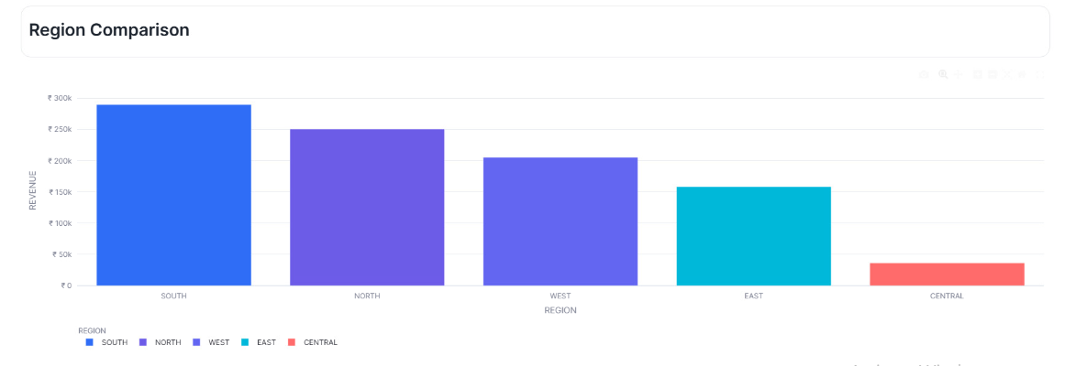
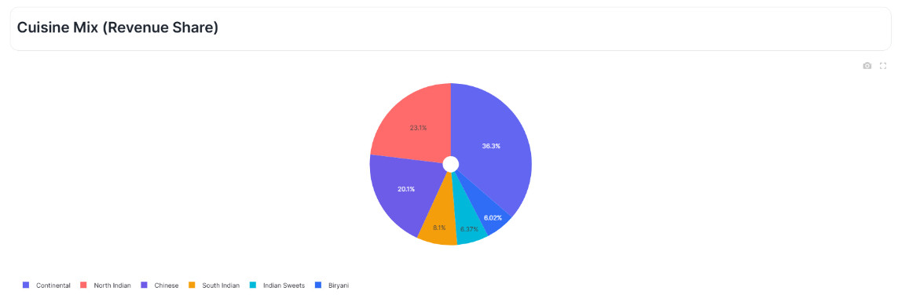
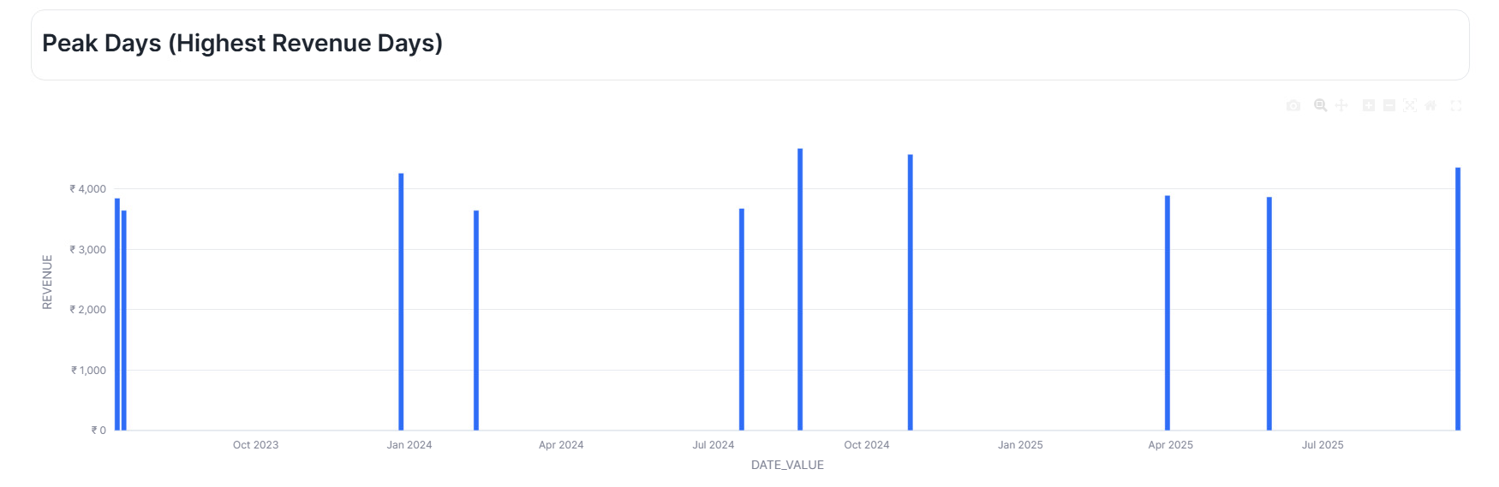
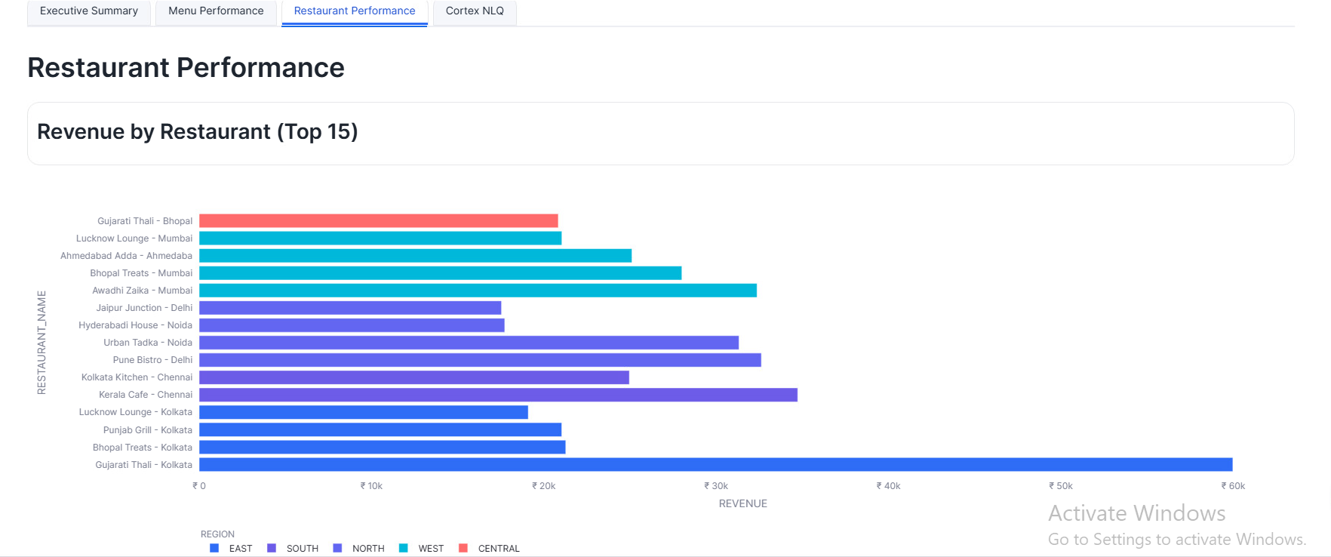

Slide 12
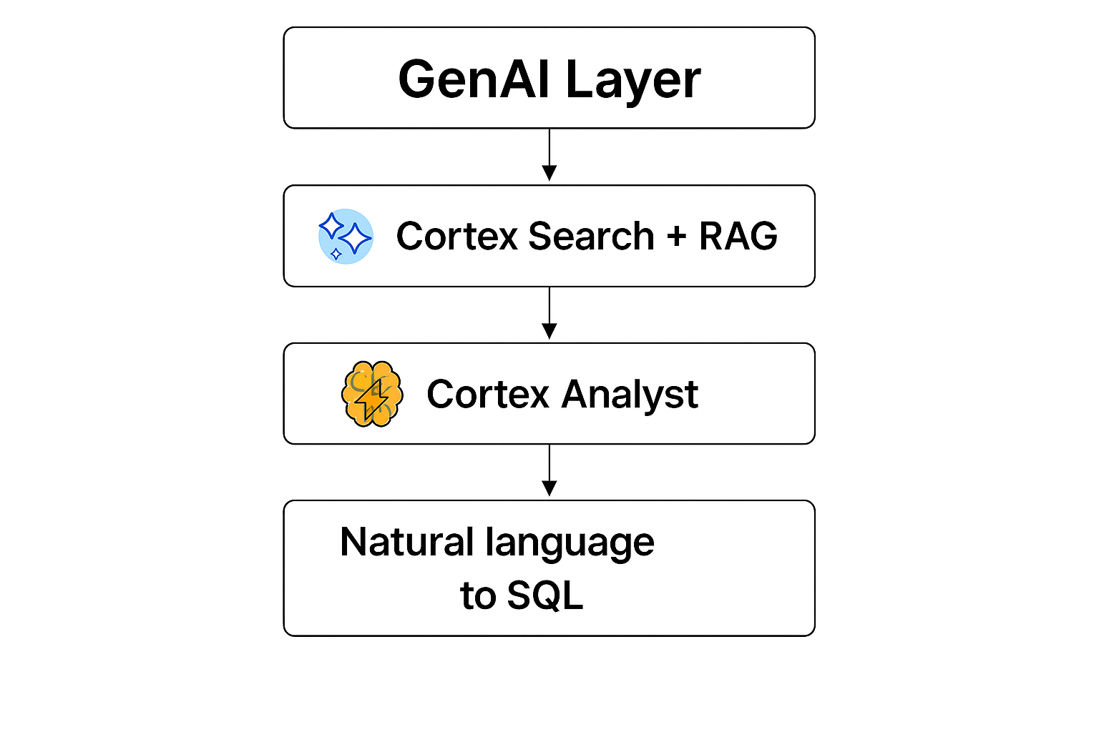
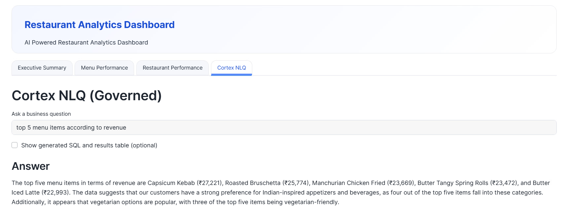
Gen AI Layer
Cortex Search with RAG for NLQ (Natural Language Querying)
Natural Language to SQL with cortex Analyst
RAG uses business logics defined by us
Add Intelligence to data platform

Slide 13
Conclusion
Our project has successfully delivers an end-to-end Restaurant Analytics Platform that automates data ingestion , cleaning , transformations and reporting using Snowflake , Informatica CDI and Streamlit .
By implementing a star schema with SCD2 and leveraging semantic views, the system provides accurate historical and business-friendly insights. With added GenAI capabilities through Cortex Search and NLQ, users can now explore data conversationally and make informed decisions with ease. Overall, the platform offers a scalable , efficient and intelligent solution for restaurant performance analysis.

Slide 14
Thank you!

